Slide 1
Sect 4.7 Using Identities to Solve Equations:
Half Angle Identities
© Copyright all rights reserved to Homework depot: www.BCMath.ca

Slide 2
Overview of Lesson
There are two parts to this lesson, the first part is about proving and applying half-angle identities:
These half angle identities should be used if “a” is a nice angle like 30, 45, 60, 90, …..
That means sine/cosine/tangent of angles like 15ᴼ, 22.5ᴼ, 67.5ᴼ, 112.5ᴼ, and so on….
The second part of the lesson is about solving equations in the form of:
This is a sum/difference of a sine and cosine
The strategy is to convert it to a Sine or Cosine of two angles
You can solve these equations without graphing

Slide 3
II) Proving Half Angle Identities:
The Half Angle identities can be easily proven using the “Double Angle Identities”
Cosine is “plus”
Sine is “minus”

Slide 4
Practice: Use the half-angle identities to find the exact values (No Calculators)

Slide 5
Given that $sin∅=\frac{3}{7}$, what is the exact value of :

Slide 6
III) Solving Trig Equations:
We can simplify a trig equation in this form to a single a trig function as a sum of two angles:
This method is for solving equations with sum of sine & cosine equal to a constant
We will learn to convert the trig equation into a single trig function by using the sum/difference identities

Slide 7
HOW to convert:
Let’s start with these equations:
The objective is to find “R” and angle “x” first…..
Identity Rcosx and Rsinx using the original equation
Square these equations and then add them, this allows us to solve for “R”
After we solve for “R”, go back and solve for “x”
NOW your equation can be easily solved in the form:

Slide 8
Convert the following to:
YOUR Equation now becomes:
With only one trig function, the equation is much easier to solve!!

Slide 9
Solve the following equations:
From the previous slides, we converted to RCosine
REMEMBER, use CAST to get both angles!!

Slide 10
Ex: Given each trig equation, indicate what substitution to make and solve for θ:

Slide 11
Ex: Given each trig equation, indicate what substitution to make and solve for θ:
You can use either one of these two:
Squaring & Combining the 2 eq above:
Slightly different if we solve for “b”
Now solve for “a”
Now solve for θ
Check you answers!!
Same answers!!

Slide 12
Ex: Given each trig equation, indicate what substitution to make and solve for θ:
You can use either one of these two:
Squaring & Combining the 2 eq above:
Again, we solve for “b”
“a” is in Q3
Now solve for θ
Same answers!!
Check you answers!!

Slide 13
This equation has no answers!
That’s because this value is greater than “R”
Start off by making a substitution
If we plug “R” back into the first equation, we get:
Suppose we have:
The range for this equation
will be:
This ratio is bigger than 1, so there will be no answers!

Slide 14
Graph:
i) Find the maximum and minimum values and also the x-values when they occur
1st Use the Sum/Diff. Identity to convert it to Rcos(+x) or Rsin(-x)
The equation can now be written in the following form:

Slide 15
Plot the coordinates of the maximum points:
Then plot the minimum points:
Middle: X-intercepts
y
4
2
x
−3π
-450
-360
-270
-180
-90
0
90
180
270
360
450
540
-2
-4

Slide 16
Given:
Add the equations:
Subtract the equations:

Slide 17
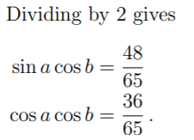
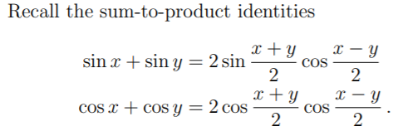
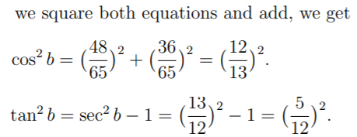
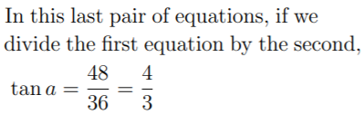
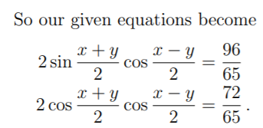

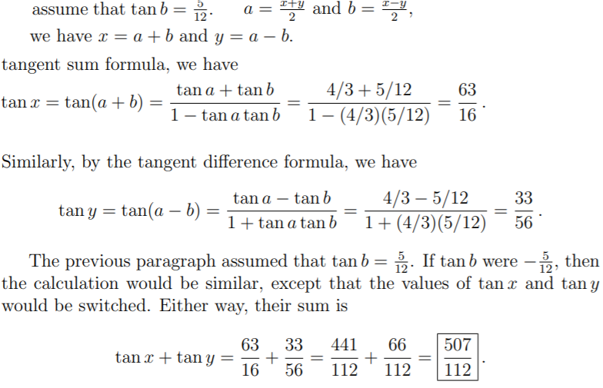
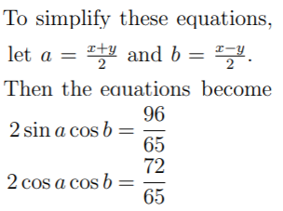
Math Prize for Girls 2014 507 / 112

Slide 18
Challenge: Prove
Sum Identities
Use the Double Angle Identities
for “sin2x” & “cos2x”
Expand/Distribute
Pythagorean Identity
Combine like-terms
© Copyright all rights reserved to Homework depot: www.BCMath.ca

Slide 19
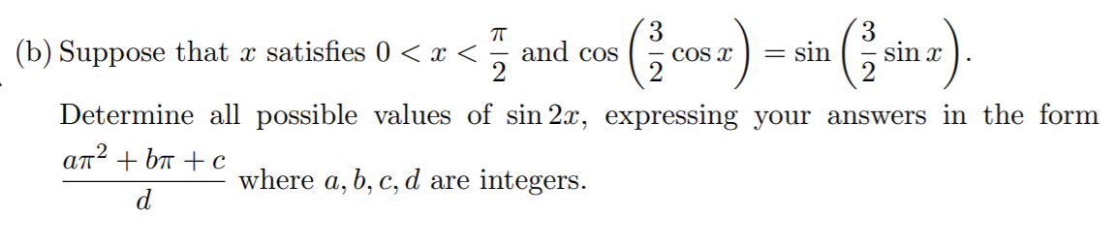

Slide 21
Challenge: Find the exact value of

